Slide 1
Ganesh Finance Project
TEAM 3
Shashwati Jha, Om Sai Karthik Pasupulleti

Slide 2
PROBLEM
Business GAP
Traditional Non-Automated Loan Management Systems are inefficient and drive away customers due to loan approval/sanction latency while also increasing dependency and costs of employing clerical staff
CUSTOMERS
All customers in India requiring a loan
ISSUE
Mishandling of documents provided by customers and no automation leading to customers availing loans from other competitors
COSTS
Loss of Market Share

Slide 3
SOLUTION
AUTOMATE SIMPLE LOAN APPLICATION TASKS
Automate loan creation, loan sanctioning and repayment
SECURE AND RESILIENT
Customer data is protected and data is resilient to corruption
EASY TO USE
Simple and easy to navigate UI for Customer, Clerk and Manager

Slide 4
AMMORTIZED LOANS
Amount paid in monthly installments. Intrest is calculated on principle. Initially, Interest paid is higher, decrease in principle leads to decrease in interest.
1st Month
Loan Principle:10,000
EMI: 1000 Rate:2%
Interest paid : 200
Principle Paid: 800
12th Month
Loan Principle:10,000
EMI: 1000 Rate:2%
Interest paid : 20
Principle Paid: 980

Slide 5
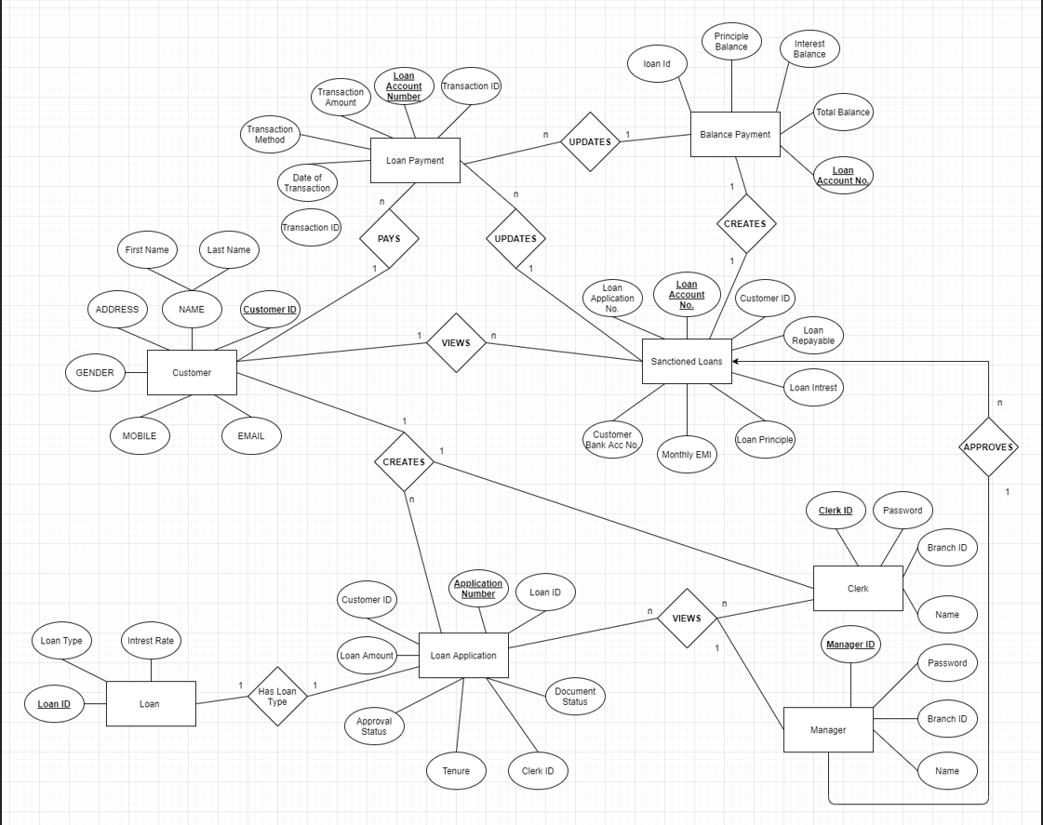
ER DIAGRAM for gfp

Slide 6
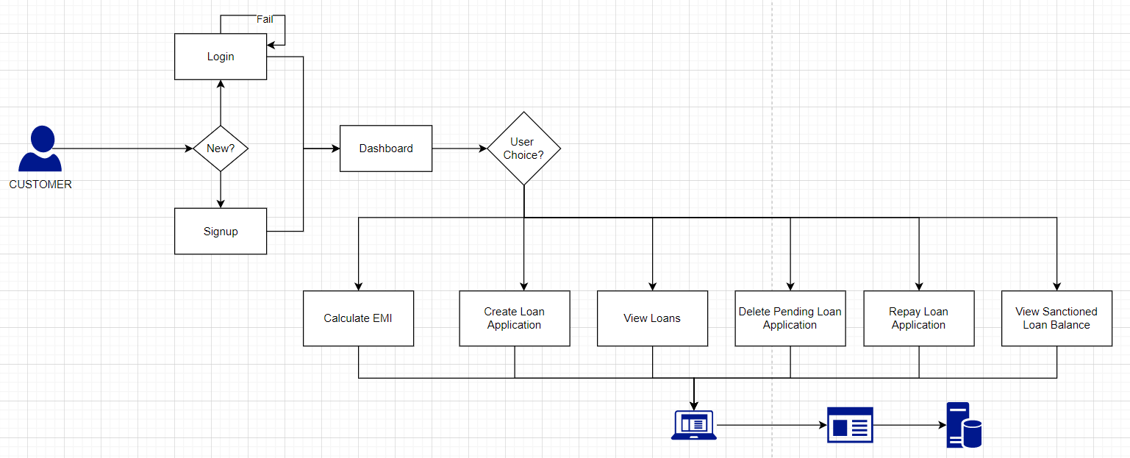
CUSTOMER FLOW

Slide 7
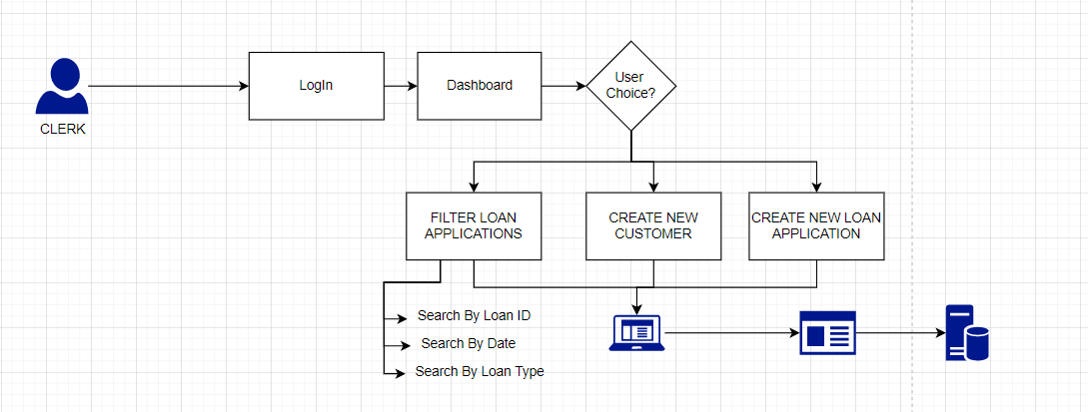
clerk FLOW

Slide 8
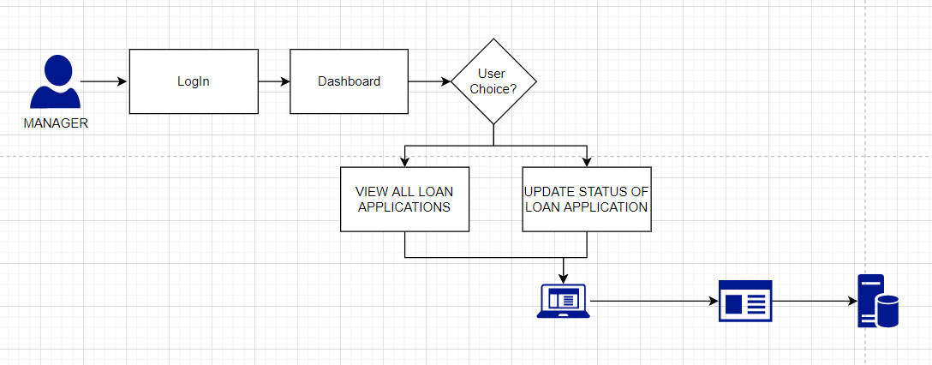
manager FLOW

Slide 9
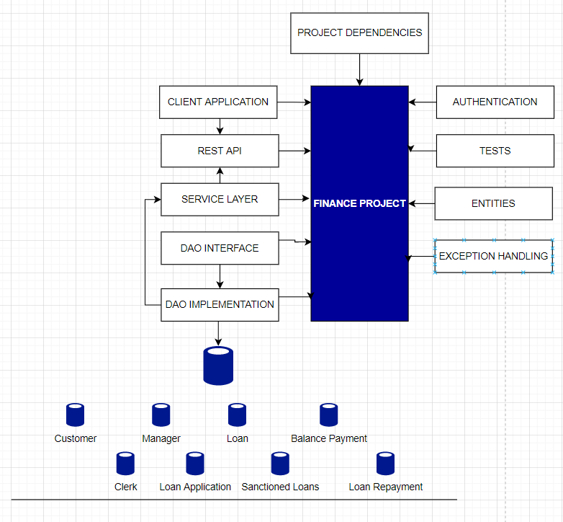
Backend Architecture

Slide 10
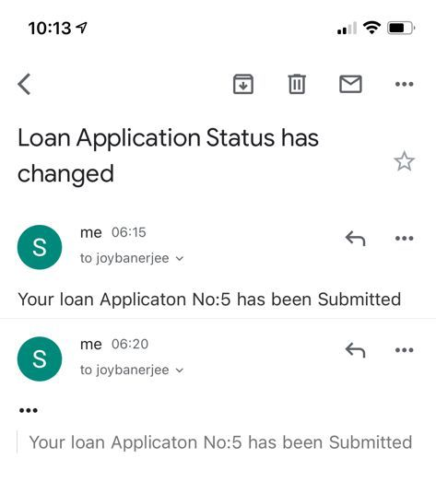
Email Customer upon loan Status Change

Slide 11
Timeline
 | 26-Aug-2021 -> 2-Sep-2021
 | 26/8Thursday |  | Friday |  | Saturday |  | Sunday |  | Monday |  | Tuesday |  | Wednesday |  | 2/9Thursday |  | Thursad
DB Creation And Design Plan
Back End Development
Http Development
Front End Development
Testing
Debugging and System Integration
GFP Maintenance

Slide 12
Thank you

